Slide 1
Lecture 3 Roots of Nonlinear Equations
CSE 2207
Numerical Methods

Slide 2
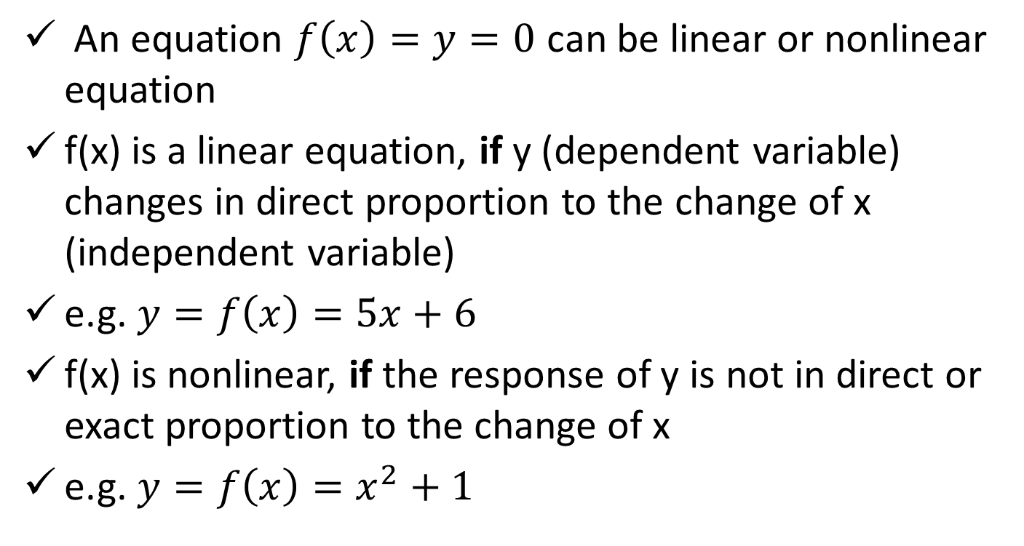
Linear vs. Nonlinear Equation
An equation $f\left(x\right)=y=0$ can be linear or nonlinear equation
f(x) is a linear equation, if y (dependent variable) changes in direct proportion to the change of x (independent variable)
e.g. $y=f\left(x\right)=5x+6$
f(x) is nonlinear, if the response of y is not in direct or exact proportion to the change of x
e.g. $y=f\left(x\right)=x^{2}+1$

Slide 3
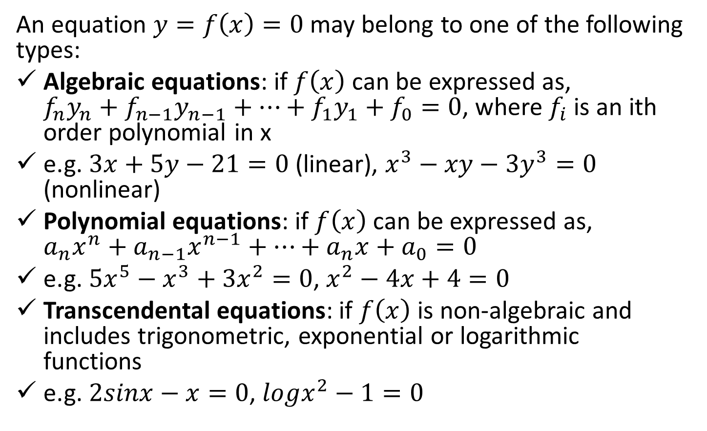
Types of Equations
An equation $y=f\left(x\right)=0$ may belong to one of the following types:
Algebraic equations: if $f\left(x\right)$ can be expressed as, $f_{n}y_{n}+f_{n−1}y_{n−1}+…+f_{1}y_{1}+f_{0}=0$, where $f_{i}$ is an ith order polynomial in x
e.g. $3x+5y−21=0$ (linear), $x^{3}−xy−3y^{3}=0$ (nonlinear)
Polynomial equations: if $f\left(x\right)$ can be expressed as, $a_{n}x^{n}+a_{n−1}x^{n−1}+…+a_{n}x+a_{0}=0$
e.g. $5x^{5}−x^{3}+3x^{2}=0$, $x^{2}−4x+4=0$
Transcendental equations: if $f\left(x\right)$ is non-algebraic and includes trigonometric, exponential or logarithmic functions
e.g. $2sinx−x=0$, $logx^{2}−1=0$

Slide 4
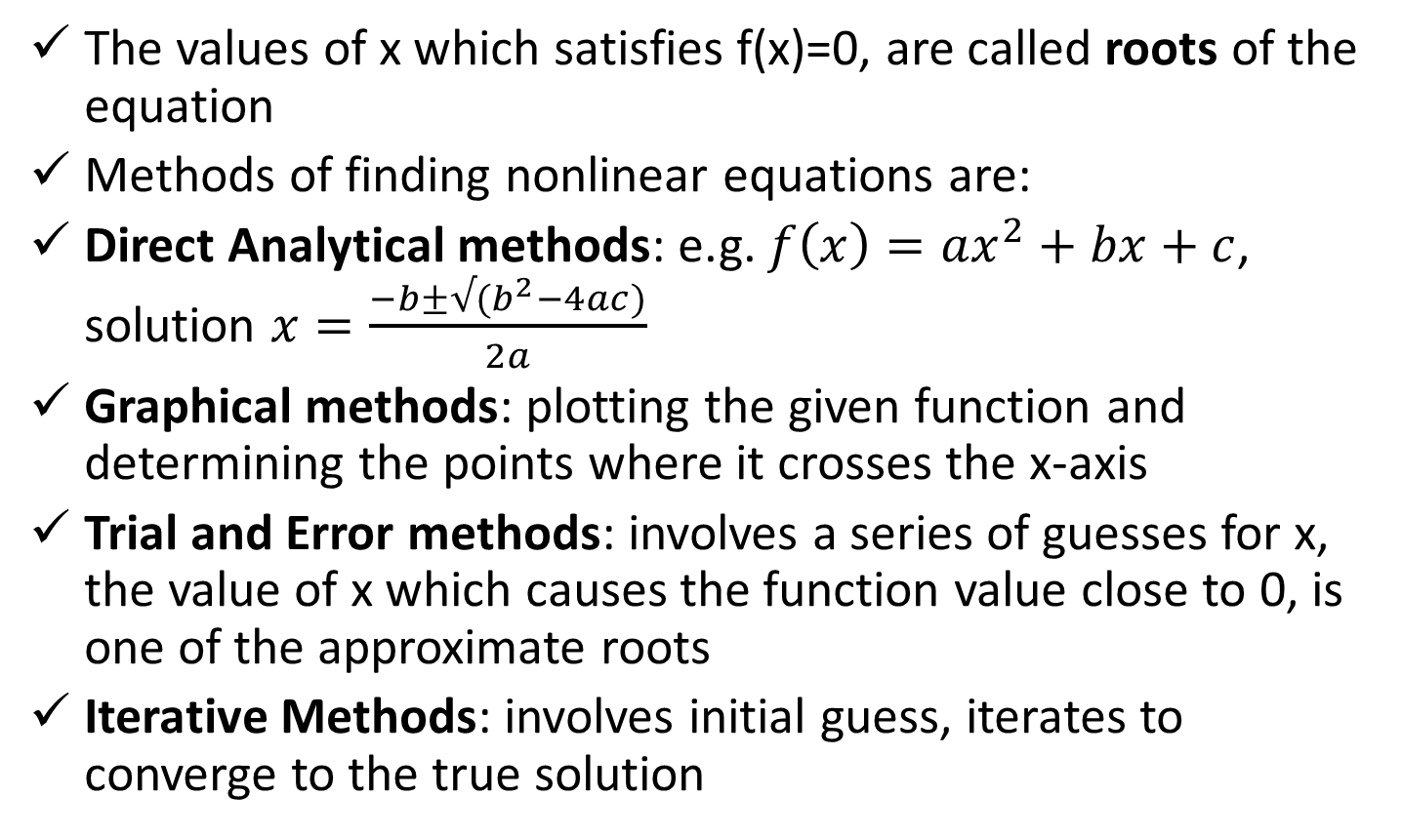
Methods of finding roots of nonlinear equations
The values of x which satisfies f(x)=0, are called roots of the equation
Methods of finding nonlinear equations are:
Direct Analytical methods: e.g. $f\left(x\right)=ax^{2}+bx+c$, solution $x=\frac{−b±√(b^{2}−4ac)}{2a}$
Graphical methods: plotting the given function and determining the points where it crosses the x-axis
Trial and Error methods: involves a series of guesses for x, the value of x which causes the function value close to 0, is one of the approximate roots
Iterative Methods: involves initial guess, iterates to converge to the true solution

Slide 5
Iterative Methods
Can be grouped into two categories:
Open end methods (Extrapolation methods): use a single starting value (or two values which not necessarily bracket the root); will be discussed:
Newton-Raphson Method
Secant Method
Bracketing methods (Interpolation methods): start with two initial guesses that bracket the root, then systematically reduce the width of bracket until the solution is found; the following 2 methods will be discussed:
Bisection Method
False Position Method

Slide 6
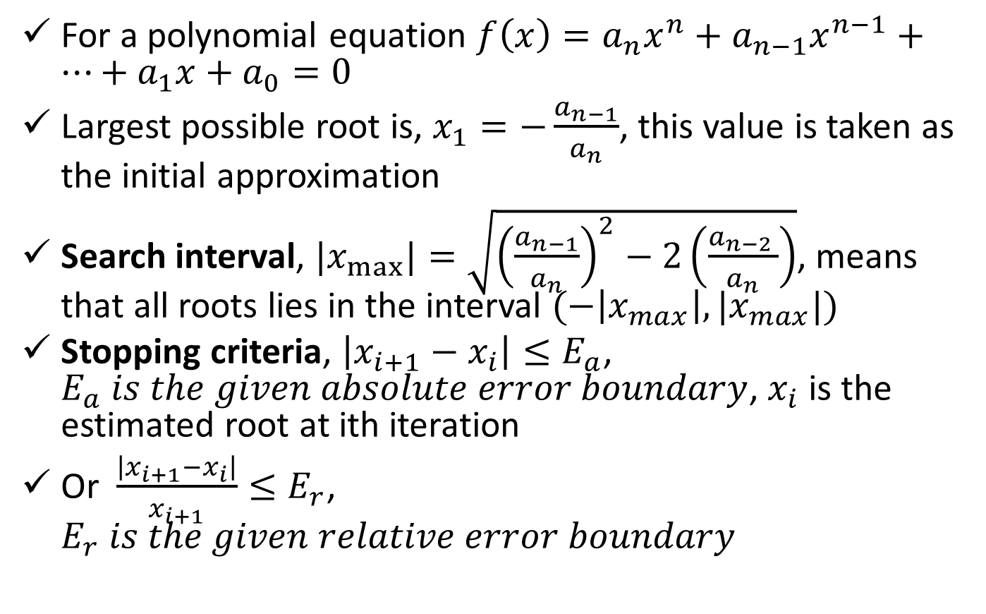
Starting and Stopping an Iterative Process
For a polynomial equation $f\left(x\right)=a_{n}x^{n}+a_{n−1}x^{n−1}+…+a_{1}x+a_{0}=0$
Largest possible root is, $x_{1}=−\frac{a_{n−1}}{a_{n}}$, this value is taken as the initial approximation
Search interval, ${|x}_{max⁡}|=\sqrt{{\left(\frac{a_{n−1}}{a_{n}}\right)}^{2}−2\left(\frac{a_{n−2 }}{a_{n}}\right)}$, means that all roots lies in the interval $(−\left|x_{max}\right|, |x_{max}|)$
Stopping criteria, $\left|x_{i+1}−x_{i}\right|≤E_{a}$, $E_{a} is the given absolute error boundary$, $x_{i}$ is the estimated root at ith iteration
Or $\frac{\left|x_{i+1}−x_{i}\right|}{x_{i+1}}≤E_{r}$, $E_{r} is the given relative error boundary$

Slide 7

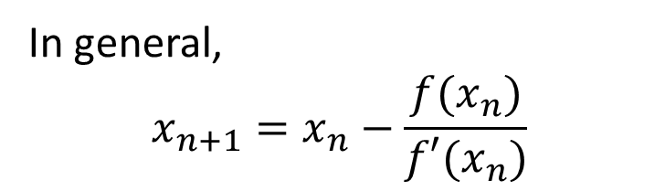
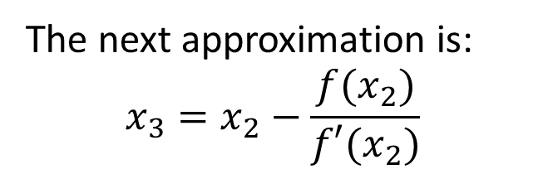
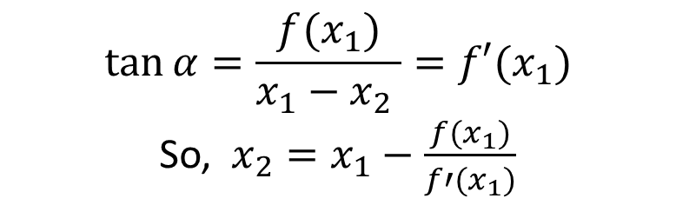
Newton-Raphson Method
x₁, f(x₁)
$$\tan{α=\frac{f(x_{1})}{x_{1}−x_{2} }=f′(x_{1})}$$
So, $x_{2}=x_{1}−\frac{f(x_{1})}{f′(x_{1})}$
x₂, f(x₂)
f(x)=0
f(x₂)
f(x₁)
f(x)
x_{r}
$$α$$
The next approximation is:
$$x_{3}=x_{2}−\frac{f(x_{2})}{f′(x_{2})}$$
x₃
x₂
x₁
x
In general,
$$x_{n+1}=x_{n}−\frac{f(x_{n})}{f′(x_{n})}$$
The method of successive approximation is called newton-Raphson method
Stop, when the difference between two successive roots is within a prescribed limit

Slide 8
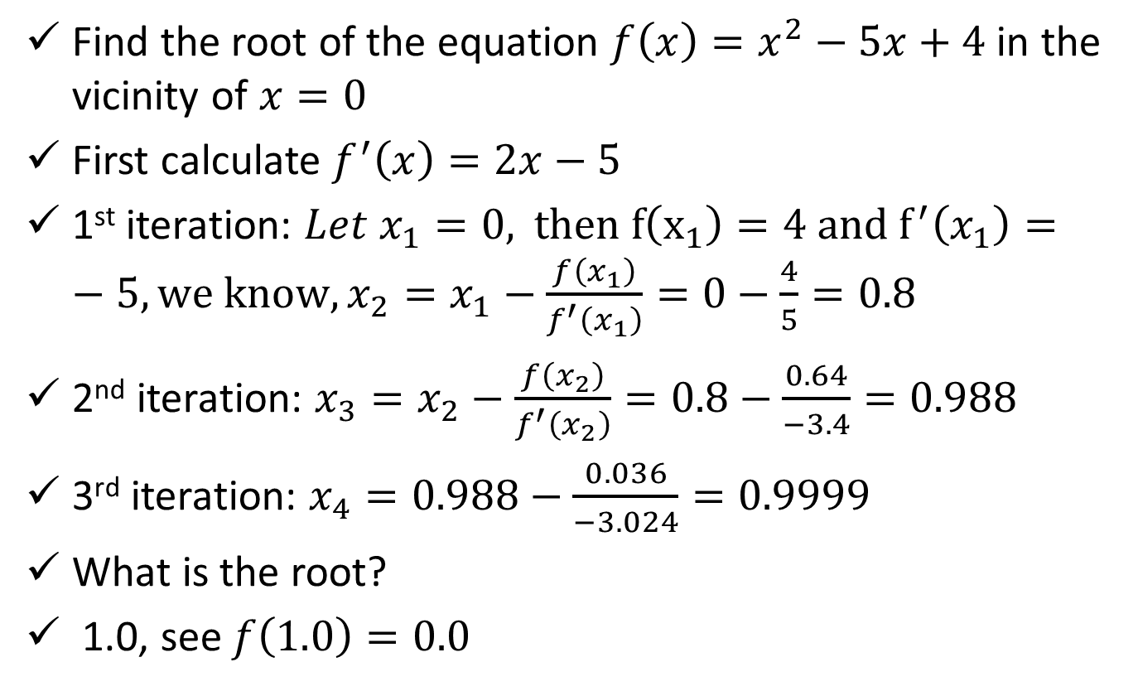
Newton-Raphson Method (cont.)
Find the root of the equation $f\left(x\right)=x^{2}−5x+4$ in the vicinity of $x=0$
First calculate $f^{′}\left(x\right)=2x−5$
1st iteration: $Let x_{1}=0,$ $then f\left(x_{1}\right)=4 and f^{′}\left(x_{1}\right)=−5, we know, x_{2}=x_{1}−\frac{f\left(x_{1}\right)}{f^{′}\left(x_{1}\right)}=0−\frac{4}{5}=0.8$
2nd iteration: $x_{3}=x_{2}−\frac{f\left(x_{2}\right)}{f^{′}\left(x_{2}\right)}=0.8−\frac{0.64}{−3.4}=0.988$
3rd iteration: $x_{4}=0.988−\frac{0.036}{−3.024}=0.9999$
What is the root?
1.0, see $f\left(1.0\right)=0.0$

Slide 9
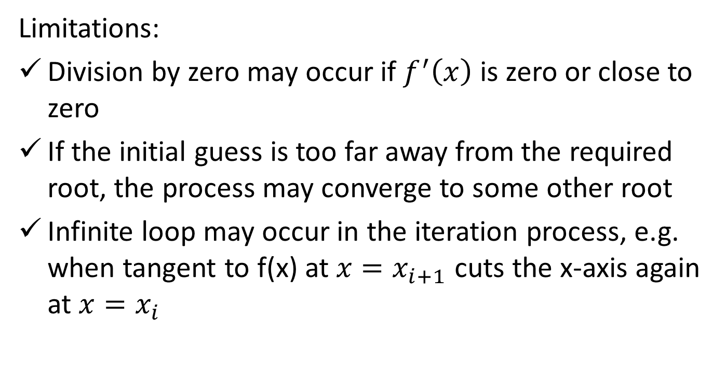
Newton-Raphson Method (cont.)
Limitations:
Division by zero may occur if $f^{′}\left(x\right)$ is zero or close to zero
If the initial guess is too far away from the required root, the process may converge to some other root
Infinite loop may occur in the iteration process, e.g. when tangent to f(x) at $x=x_{i+1}$ cuts the x-axis again at $x=x_{i}$

Slide 10
References
Numerical Methods by E Balagurusamy

